Slide 1


NEXT GEN EMPLOYABILITY PROGRAM
CREATING A FUTURE-READY WORKFORCE

Slide 2
Student Name : Purnendu Shekhar Achary
Student ID : STU64662949e91ac1684416841
College Name : GITA Autonomous College, Bhubaneswar

Slide 3
CAPSTONE PROJECT SHOWCASE
Project Title : E-Commerce Sale Analysis using Power BI
Abstract | Problem Statement | Project Overview | Proposed Solution | Technology Used | Modelling & Results | Conclusion | Q&A

Slide 4
Abstract
Problem Statement:
E-commerce struggles with fragmented sales data, hindering strategic decisions and growth.
Project Overview:
Revolutionizing E-commerce analysis using Power BI for real-time insights and informed decision-making.
Proposed Solution:
Leveraging Power BI's analytics for comprehensive E-commerce sales data visualization and trend identification.
Technology Used:
Primary reliance on Power BI, seamlessly connecting diverse E-commerce platforms for unified, accurate datasets.
Modelling & Result:
Meticulous data modelling in Power BI yields user-friendly dashboards, KPIs, and actionable insights for stakeholders.
Conclusion:
Transformative impact of Power BI in decoding complex data sets, empowering businesses for adaptive growth.

Slide 5

Problem Statement
Data Visualization:
E-commerce businesses face the imperative to optimize sales strategies for sustained growth. The need for a concise E-commerce Sales Analysis, powered by tools like Power BI, is crucial in understanding customer behavior, market trends, and operational efficiency.
Data Insights:
Extracting meaningful insights from large volumes of sales data can be a daunting task, obstructing the formulation of effective business strategies.

Slide 6
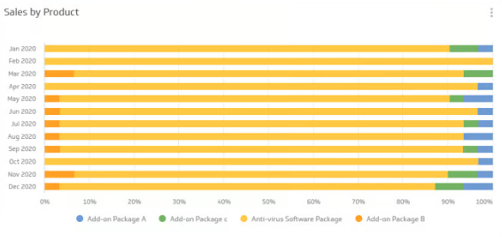
Project Overview
Data Collection:
Collecting e-commerce sales data from various sources and integrating it into a centralized database for ease of analysis and reporting.
Data Analysis & Visualization:
Processing and examining vast volumes of sales data to uncover trends, patterns, and actionable insights that can drive business decisions.
Dashboard Creation:
Developing interactive and visually appealing Power BI dashboards to present key sales metrics and facilitate real-time monitoring and analysis.

Slide 7
Proposed Solution
1
Data Integration:
Integrating data from multiple e-commerce platforms to create a consolidated view of sales data for comprehensive analysis.
2
Custom Visualization:
Developing custom visualizations in Power BI to effectively communicate sales insights and performance to stakeholders.
3
Automated Reporting:
Implementing automated reporting capabilities to schedule and distribute critical sales reports to decision-makers.
4
Real-time Monitoring:
Enabling real-time monitoring of sales trends and performance through live Power BI dashboards for prompt decision-making.

Slide 8


Technology Used
Power BI:
An extensive use of Power BI's robust capabilities in data visualization, reporting, and real-time analysis for comprehensive sales insights.
SQL Database:
Leveraging SQL databases for efficient storage, management, and retrieval of large volumes of
e-commerce sales data for analysis.
Cloud Services:
Utilizing cloud services for seamless data storage, scalability, and accessibility, ensuring smooth e-commerce sales data management.

Slide 9
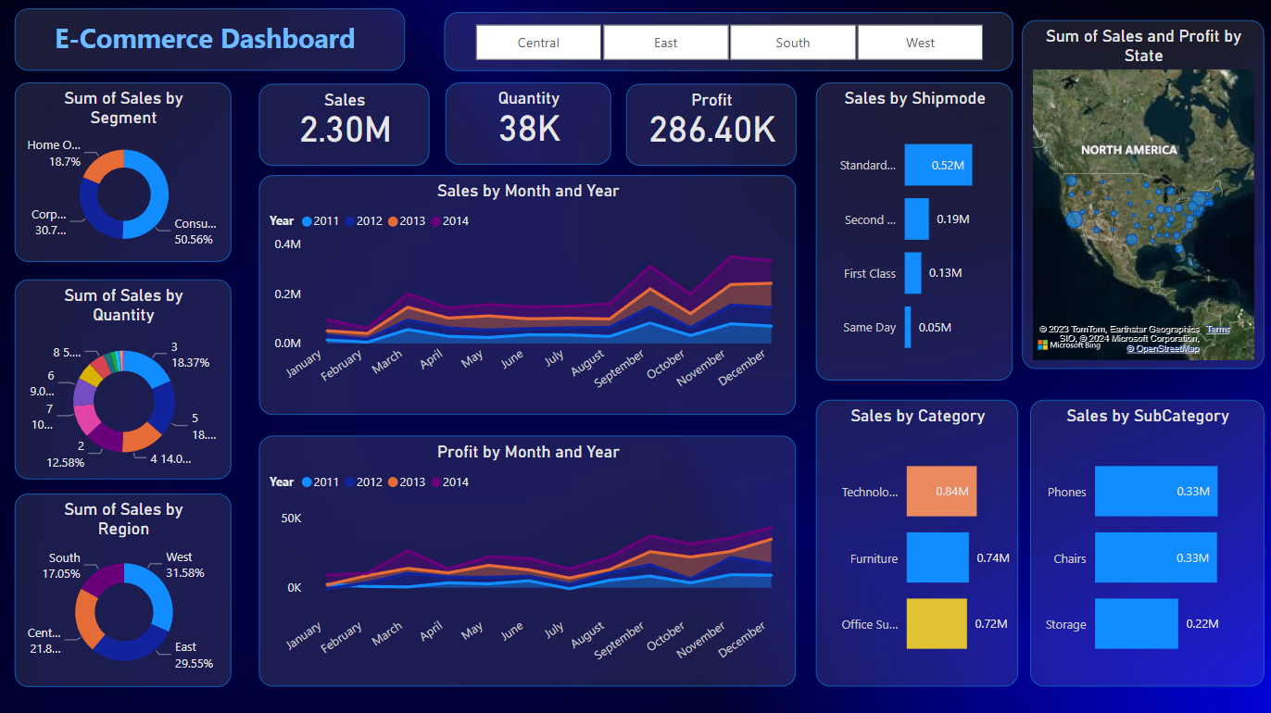
Modelling & Results
Analysis Summary
From the dashboard, it appears that the company’s sales and profits have been growing steadily over the years. The Consumer segment and the East region are significant contributors to sales. Technology products, especially Phones, are the top-selling items.
These insights could be useful for the company to focus its marketing and sales strategies effectively. However, it would be beneficial to analyze the factors contributing to the lower sales in the Home Office segment and the South region to identify potential improvement areas. Also, understanding why Phones are the top-selling items could help in promoting other products as well.
•Top Metrics: Total Sales are 2.30M, Quantity Sold is 38K, and Total Profit is 286.40K. These metrics provide a snapshot of the company’s overall performance.
• Sales and Profit Trends: Both sales and profit have shown a steady increase from 2011 to 2014.
This indicates the company’s growth and profitability over time.
• Sales by Category and Sub-Category: Technology leads the sales category, with Phones being the top-selling subcategory. This suggests that technology products, particularly phones, are the company’s best-selling items.

Slide 10



Conclusion
Data-Driven Decisions
Making informed decisions backed by data insights to optimize marketing strategies, product offerings, and customer experiences.
Continuous Monitoring
Realizing the importance of continuous monitoring of sales trends and patterns to adapt swiftly to the dynamic
e-commerce landscape.
Business Growth
Utilizing advanced sales analysis to drive revenue growth, enhance customer retention strategies, and capitalize on market opportunities.

Slide 11
Thank You!
Notes:
Thank You !!

